Slide 1
Capstone Project – The Battle of Neighborhoods
Anastasiya Lyamina, 07/05/2020

Slide 2
Introduction
Business Problem
Target Audience
Challenge: finding the most suitable flat to live in London, considering cost of living and common entertainment venues in the boroughs
Get an insight into the house median price and the life satisfaction score for each of 33 London boroughs
Real Estate Agents
Potential customers (rental or buying)

Slide 3
Data acquisition
London boroughs information: Excel file downloaded from the data.gov.uk
Foursquare API
Python libraries:
Pandas - Library for Data Analysis
GeoPy – Library to get the geo codes of London boroughs
NumPy – Library to handle data in a vectorized manner
Requests – Library to handle http requests
Matplotlib and Seaborn – Python Plotting Module
Sklearn – Python machine learning Library
Folium – Map rendering Library

Slide 4
Data cleaning
3rd data frame:
Final: merging first 2 data frames together
Merging
2nd data frame:
getting the geo codes information for each borough
GeoPy and Nominatum Python Packages
1st data frame:
Renamed, dropped columns, dropped rows, keeping only required information
Excel file from data.gov.uk website

Slide 5
Methodology
Using the final dataset containing the boroughs in London, its information about the house prices and life satisfaction score, along with the latitude and longitude, we can find all the Arts & Entertainment venues within a 1000 meter radius of each borough by connecting to the Foursquare API. This returns a JSON file containing all the venues in each borough, which is converted to a Pandas data frame. This data frame contains all the venues from the specified category along with their coordinates and sub-category. The file contains columns of Borough, Venue Name, Venue Latitude, Venue Longitude and Venue Category. The next step is One hot encoding – a process by which categorical variables are converted into a form that could be provided to ML algorithms to do a better job in prediction.

Slide 6
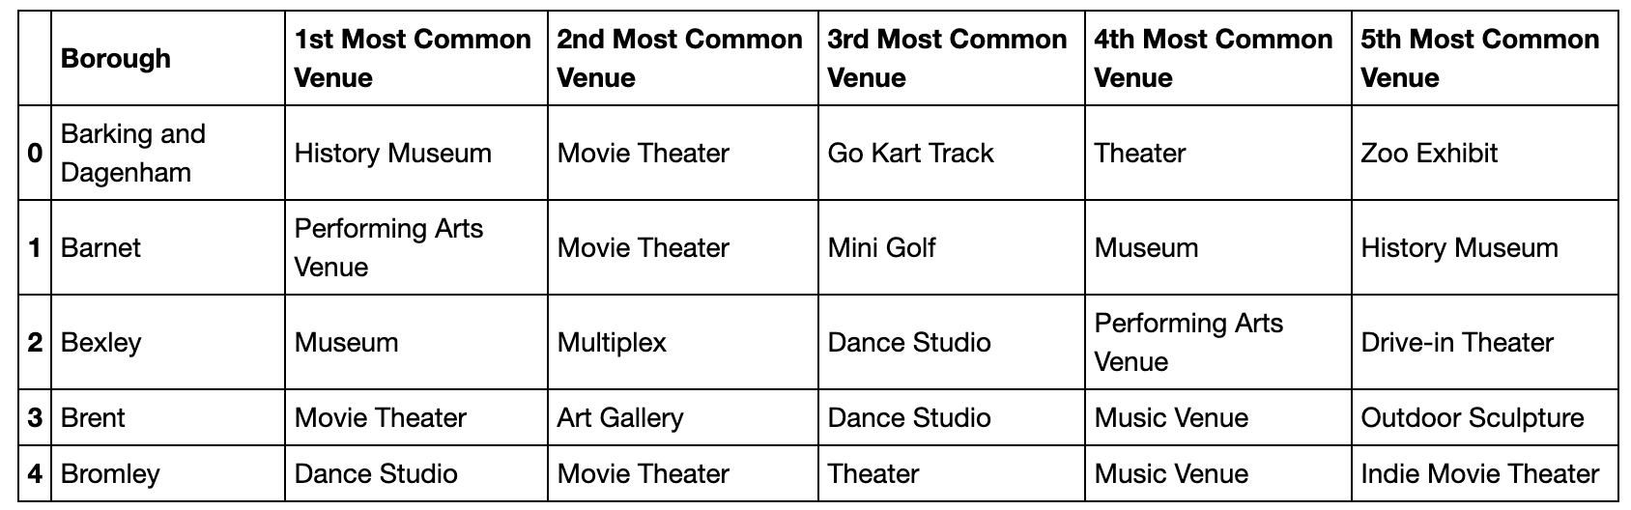
One hot encoding
One hot encoding is done on the venues data.
The venues data is then grouped by the borough and the mean of the venues are calculated, finally the 5 common sub-categories are calculated for each of the boroughs.
This information is then transformed in a table, so each row shows 5 most common venues for each borough. The first 5 rows in the result table:

Slide 7
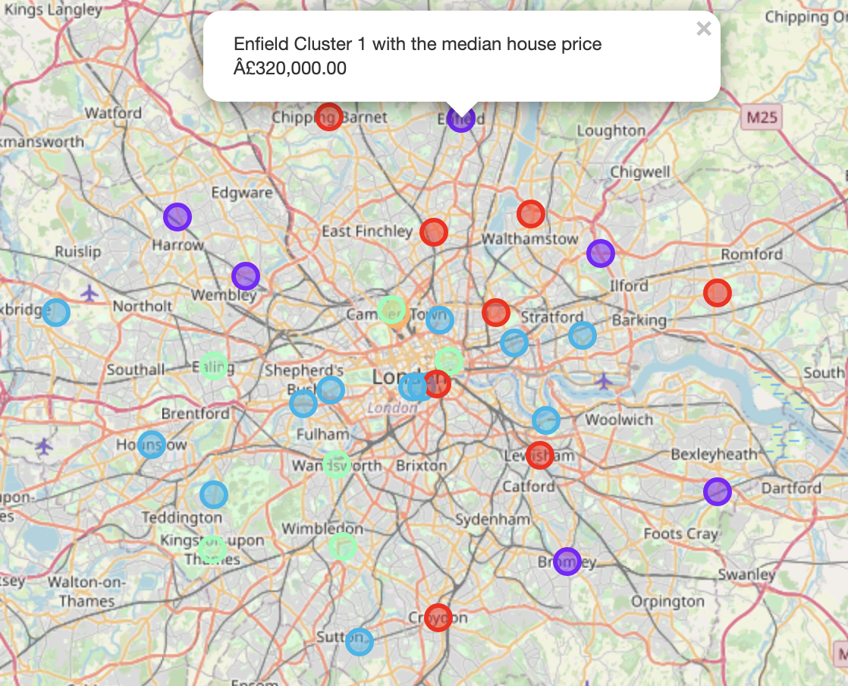
Modelling: K-means clustering
We built the model by clustering similar boroughs using K - means clustering based on the Arts & Entertainment venues
Cluster size = 5
Resulted in clustering 33 boroughs into 5 clusters
When visualised, we also added the information of the Median House Price to each point

Slide 8
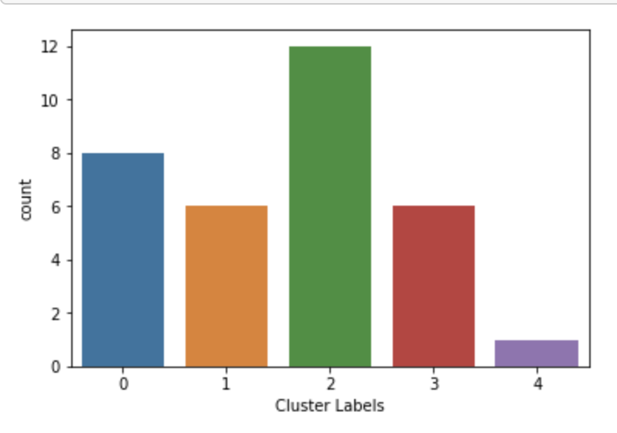
Results
Cluster 0
Art Gallery – most common
Median House Price – range of 300k-485k
Cluster 1
Dance Studio – most common
Number Of Active Business > 15k
Cluster 2
Biggest cluster (12 of 33 boroughs)
Dance Studio, Movie Theatre and Multiplex – combination, most common
Gross Annual Pay – range of 30-33k
Cluster 3
Cluster 4
Theatre – most common
Only one borough inside – Camden,
Zoo Exhibit – most common, not listed anywhere else
The most frequent venues are Theatre and Dance Studio. Zoo Exhibit, Museum, Exhibit and Comedy Club are the ones mentioned the least times.
Count of boroughs in each cluster:

Slide 9
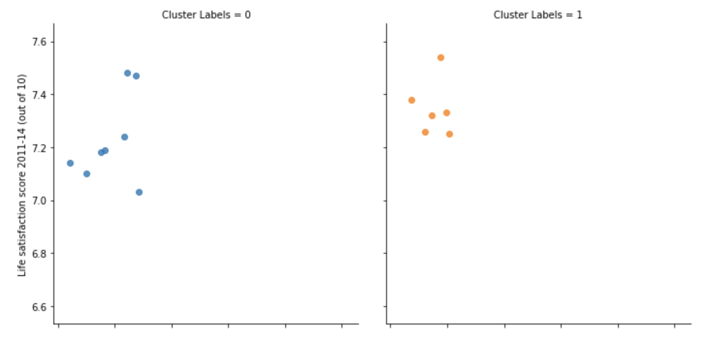
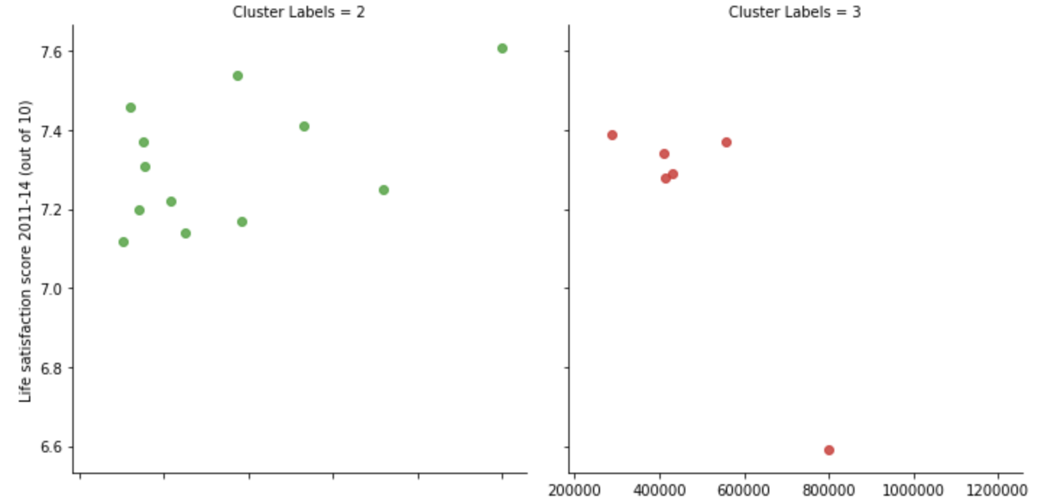
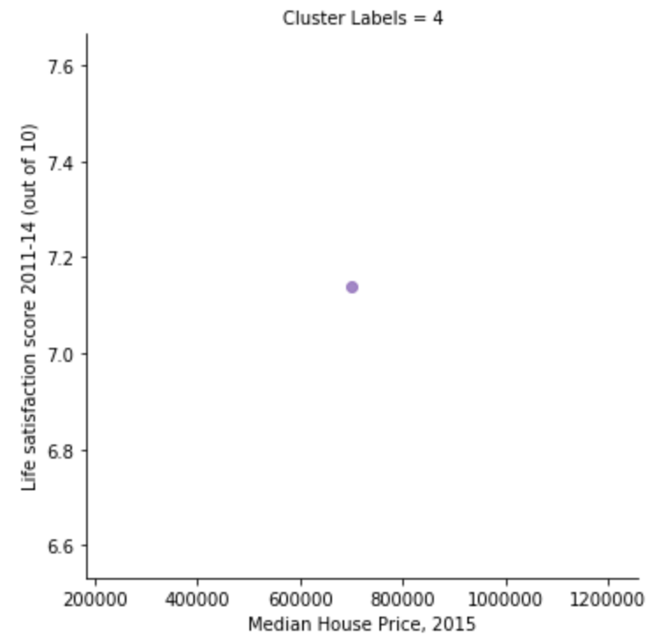
Life Satisfaction Score and Median House Price
0
1
2
3
By plotting the clusters data from Median House Price and Life Satisfaction Score, it’s shocking to see the correlation between these 2 features in some clusters. Ignoring Cluster 4 with just 1 borough and Cluster 2 with no obvious correlation, all other clusters (Cluster 0, 1, 3) have a visible tendency, especially Cluster 3 with range of Life Satisfaction score 7.2-7.4 apart from 1 outlier.
4

Slide 10
Discussion
Diving 33 London boroughs with various Median House Price into 5 clusters makes it easy to pick boroughs to look into in more detail for living.
If interested in one borough, it is worth to look at boroughs which sit in the same cluster.
Taking the Arts & Entertainment interests into account:
For young professionals or students -> Cluster 1 (Dance Studio)
For conservative people and families -> Cluster 3 (Theatre)
The choices of boroughs may vary from person to person.
Life Satisfaction Score: the majority of boroughs have a score in the range of 7.2 and above, which makes it tough to consider this feature for decision making.

Slide 11
Conclusion
This project gives the first glance on the process of how it can be done, although the analysis has been performed on the limited data:
Foursquare API: limitation to Arts & Entertainment category; radius of 1000 meters; limit of 100 venues
Clustering: performed on the Foursquare venue information only, not considering the price or life satisfaction score or other available features
Scope: limitation to London and its boroughs

